Slide 1
Big Data – Amazon Web Services Week 10
Professor Arturo Castellanos, PhD
Assistant Professor – William & Mary
Big Data - MSBA

Slide 2

Agenda
- Create EC2 Instance
- Fix Spark
=> Add the Spark files into c:\spark
=> Add the Winutils files into your SPARK_HOME\bin
=> Modify the environment variables
==> JAVA_HOME
==> SPARK_HOME
==> Add bin folders to Path
- Hands-on: Spark transformations and actions
- Hands-on: Titanic Spark DataFrame. Spark SQL titanic exercise --pause video.
- Group project: Alpha example, twitter topic analysis.

Slide 3
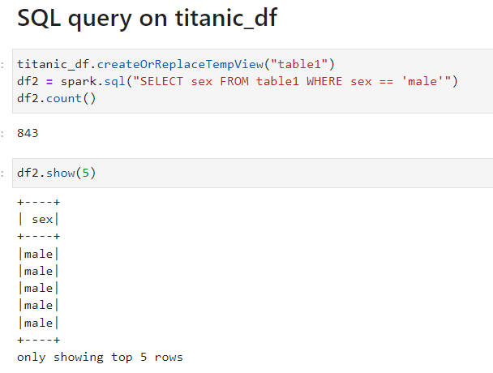
Executing SQL Queries
The SparkSession provides a method called sql which can be used to execute a SQL query.
The sql method takes a SQL statement as an argument and returns a DataFrame representing the result of the given query.
Unfortunately, SQL queries cannot be run directly against a DataFrame. To issue SQL queries against an existing DataFrame we can leverage the createOrReplaceTempView function to build a temporary table
After creating the temporary table, we can simply use the sql method, which allows us to write SQL code to manipulate data within a DataFrame.

Slide 4
Executing SQL Queries
The SparkSession provides a method called sql which can be used to execute a SQL query.
The sql method takes a SQL statement as an argument and returns a DataFrame representing the result of the given query.
Unfortunately, SQL queries cannot be run directly against a DataFrame. To issue SQL queries against an existing DataFrame we can leverage the createOrReplaceTempView function to build a temporary table
After creating the temporary table, we can simply use the sql method, which allows us to write SQL code to manipulate data within a DataFrame.

Slide 5
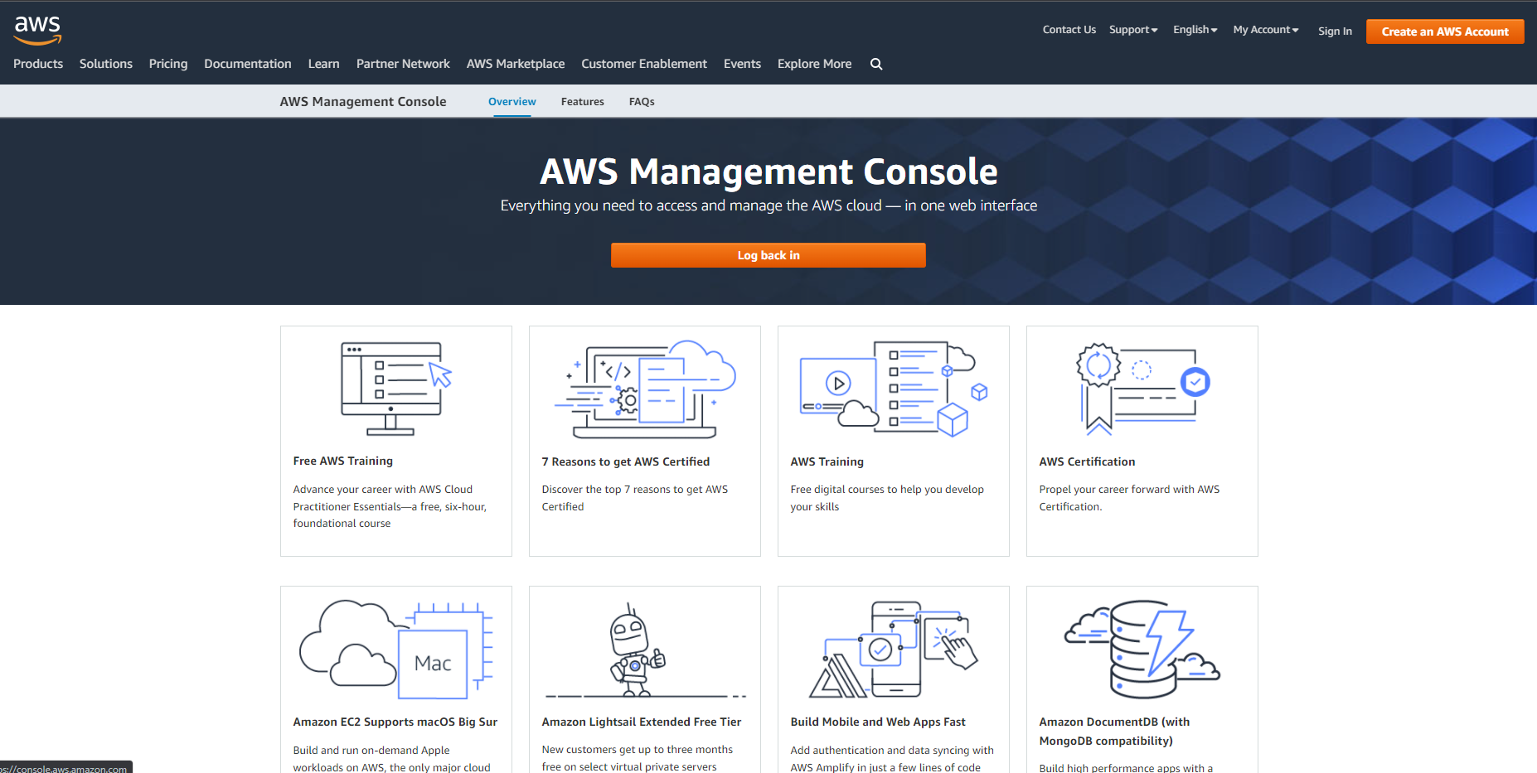
aws.amazon.com

Slide 6
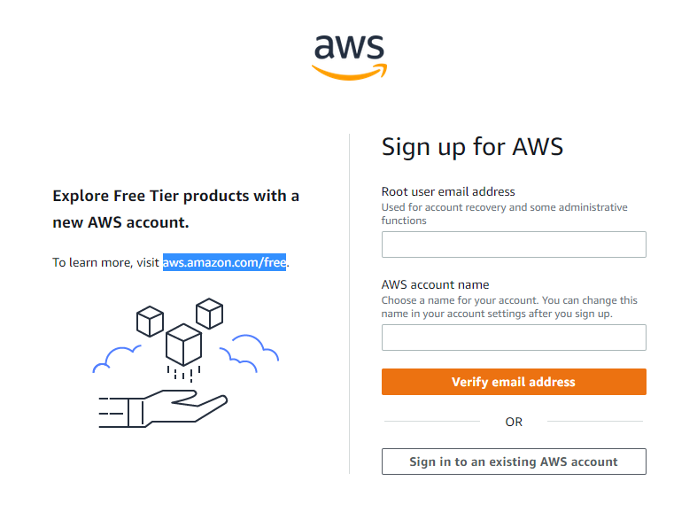

Slide 7
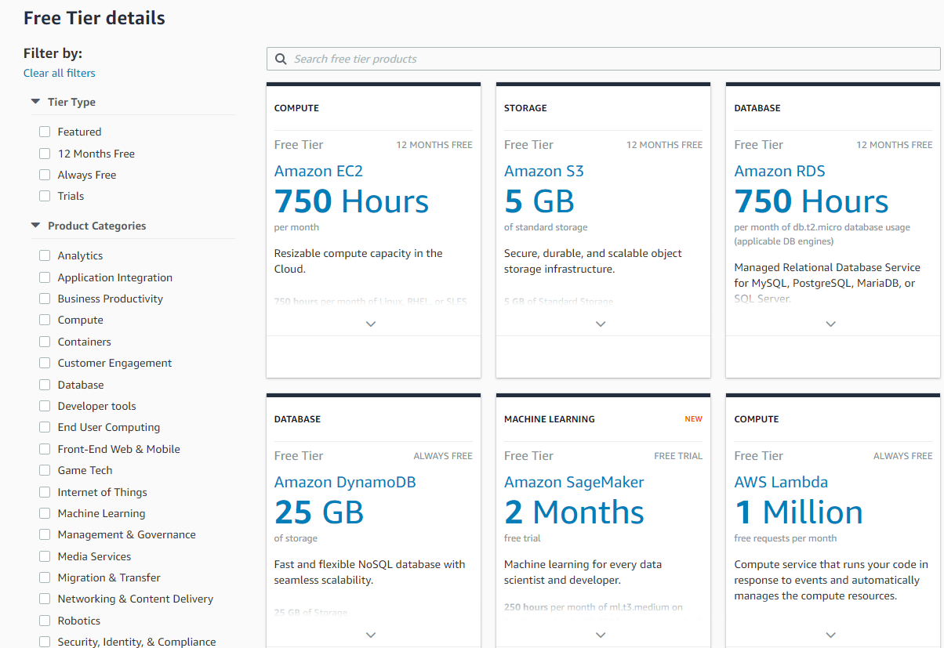

Slide 8
Agenda
Interacting with an API
Requesting a Key
Look at the documentation for endpoints
Use pandas to shape the data and select what you need
Working with AWS S3 (Simple Storage Service)
Getting your keys
Creating a bucket in S3
Listing the buckets in S3
Saving data into S3
Retrieving data from S3

Slide 9
Jupyter Notebook

Slide 10
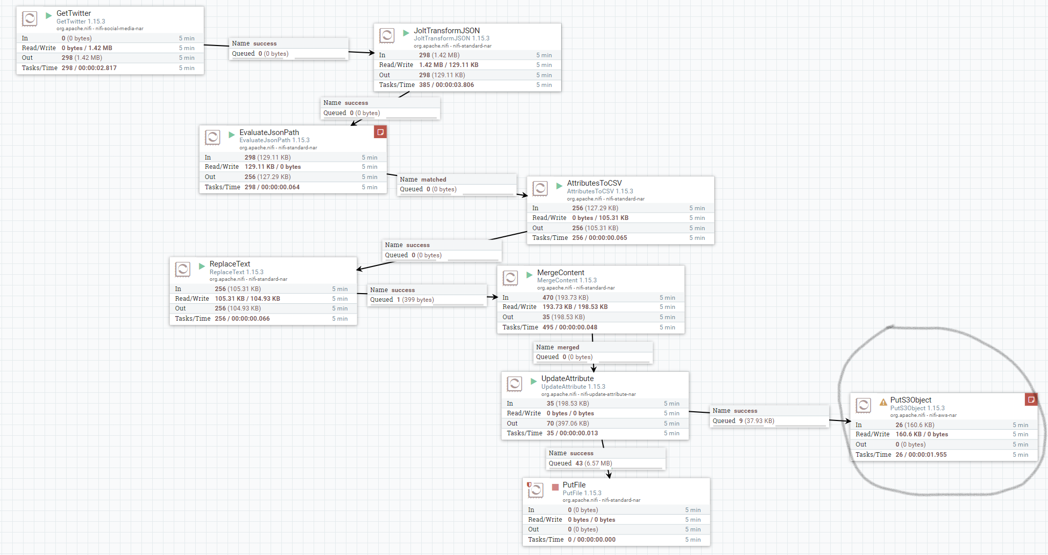
Nifi

Slide 11
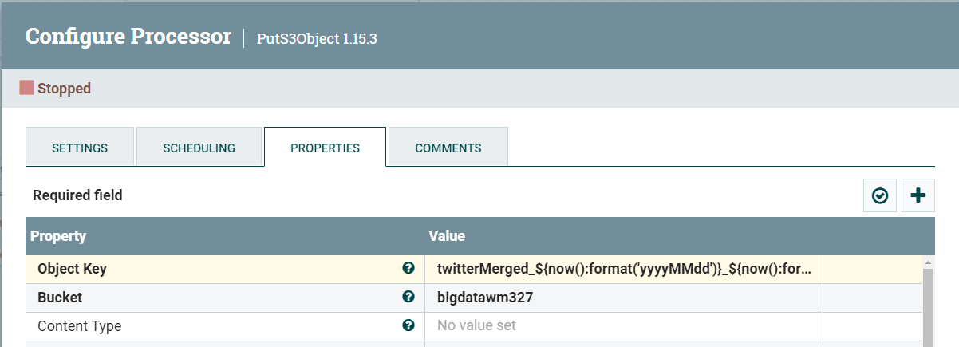
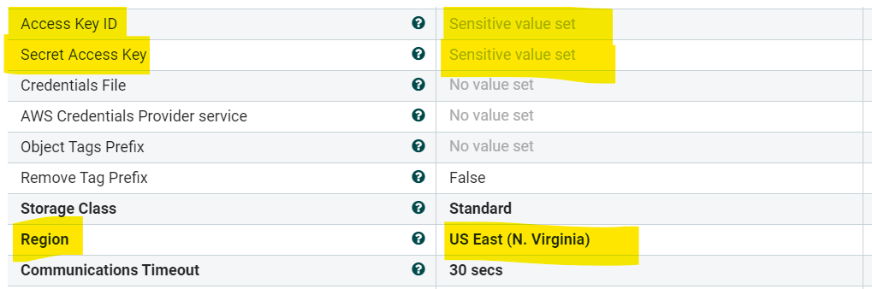
PutS3Object

Slide 12
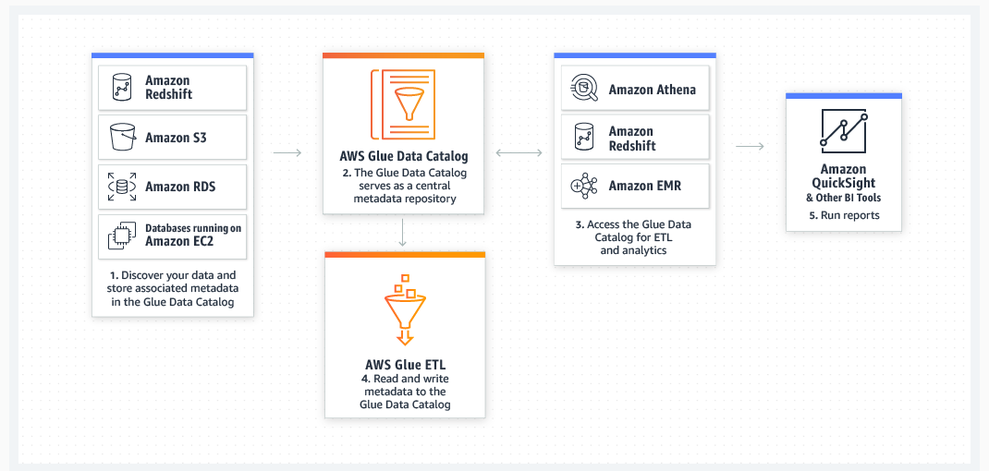
AWS GLUE
Data integration is the process of preparing and combining data for analytics, machine learning, and application development. It involves multiple tasks, such as discovering and extracting data from various sources; enriching, cleaning, normalizing, and combining data; and loading and organizing data in databases, data warehouses, and data lakes.

Slide 13
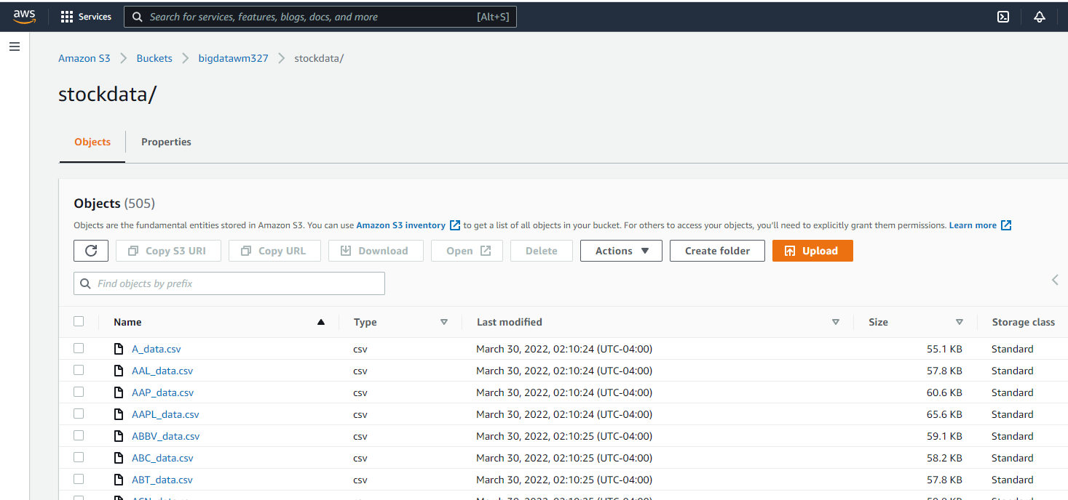

Slide 14
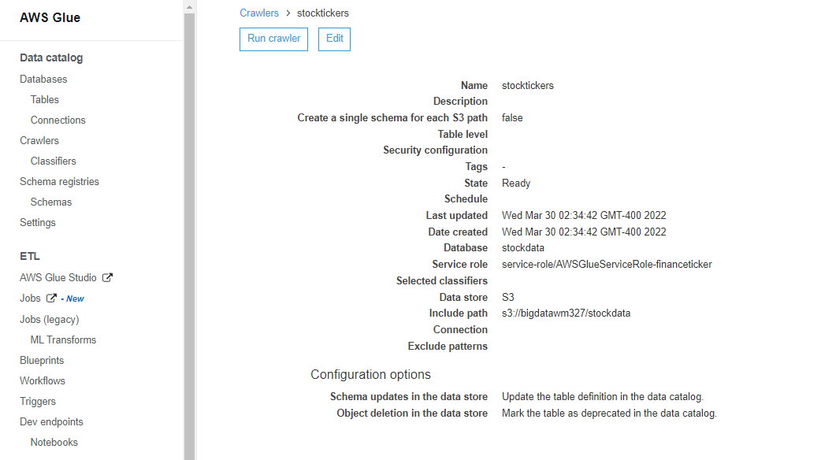

Slide 15
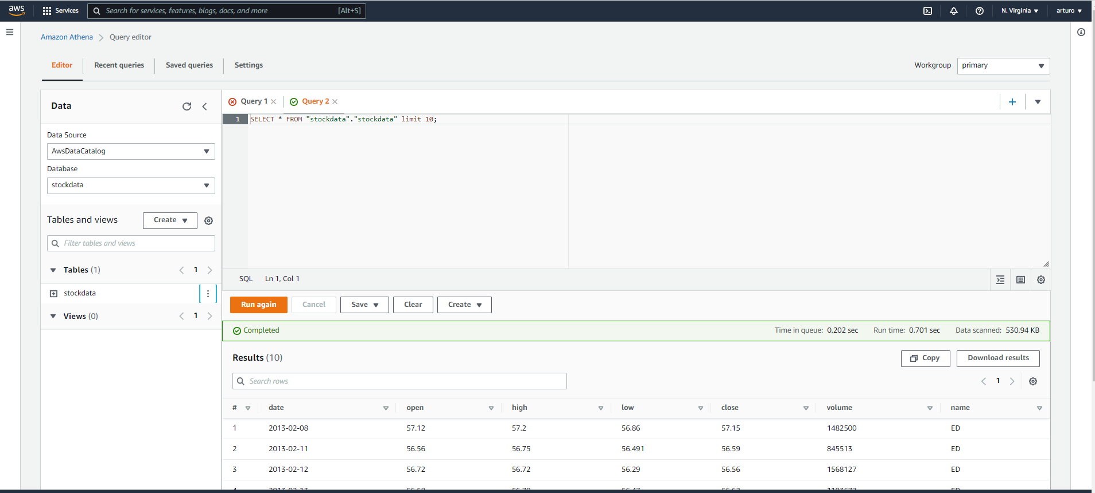
Amazon Athena

Slide 16
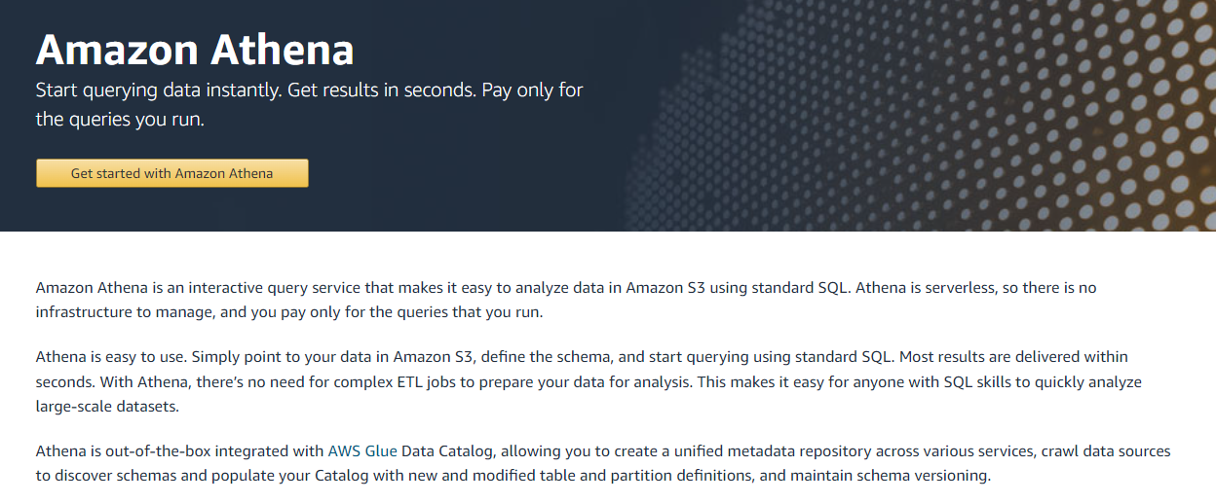
Amazon Athena

Slide 17
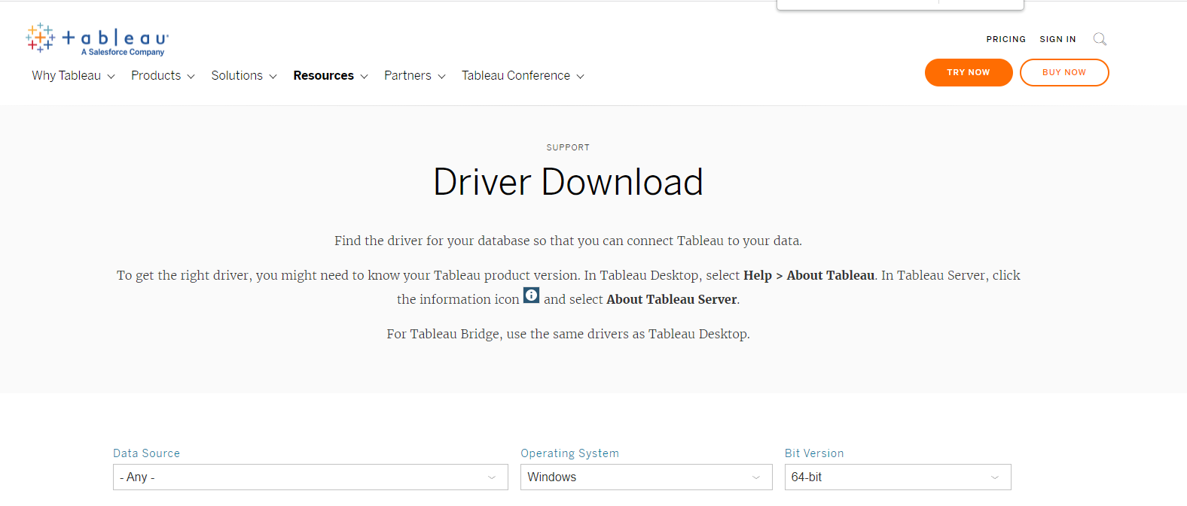
Connecting Athena to Tableau
https://www.tableau.com/support/drivers?edition=

Slide 18
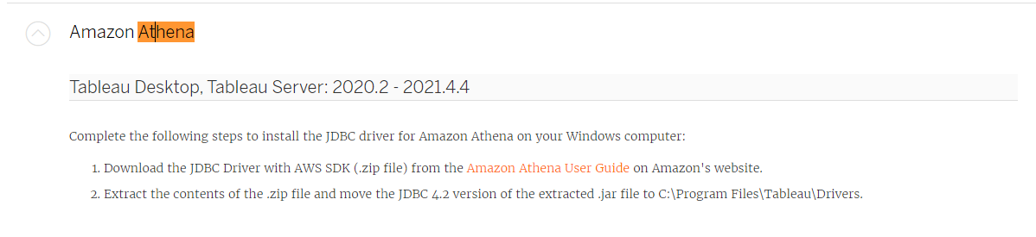
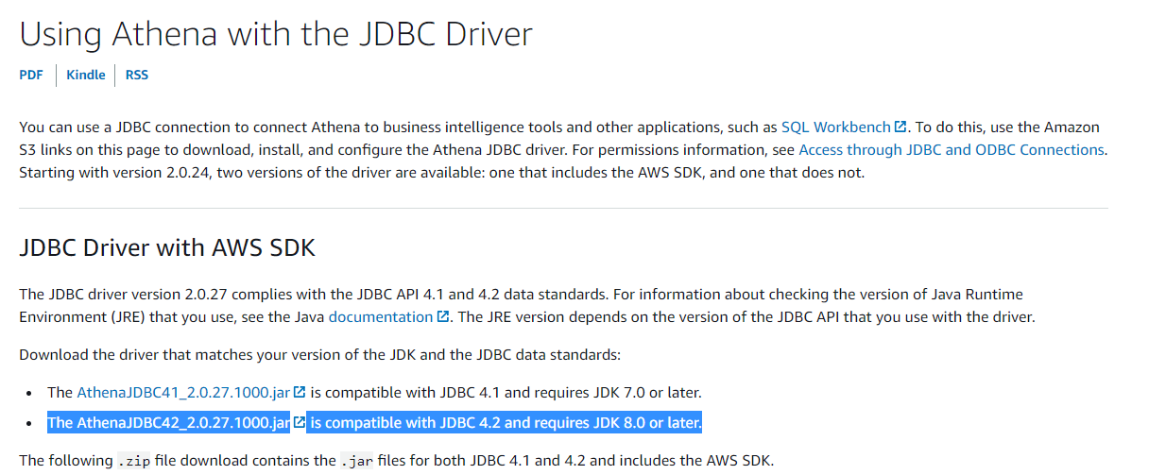

Slide 19
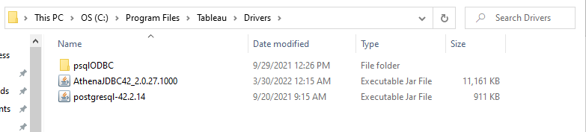
Once you download the driver just move it to your Tableau/Driver folder

Slide 20
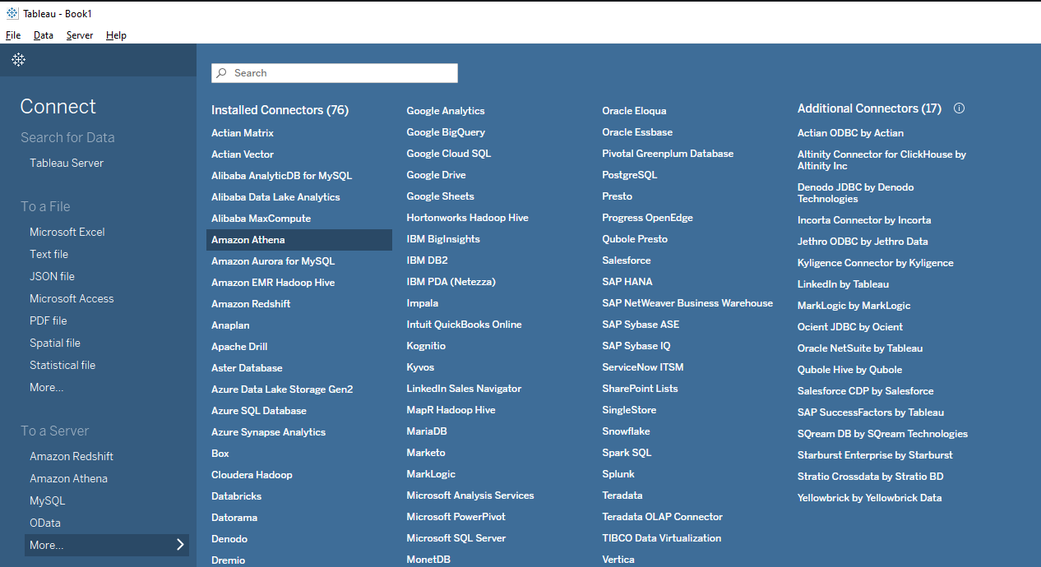
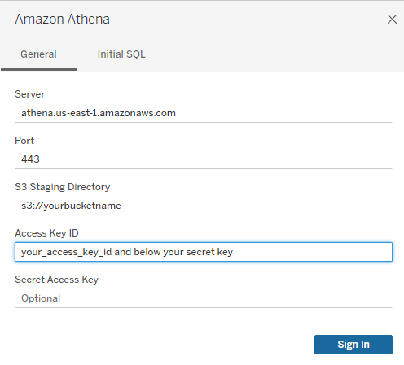

Slide 21
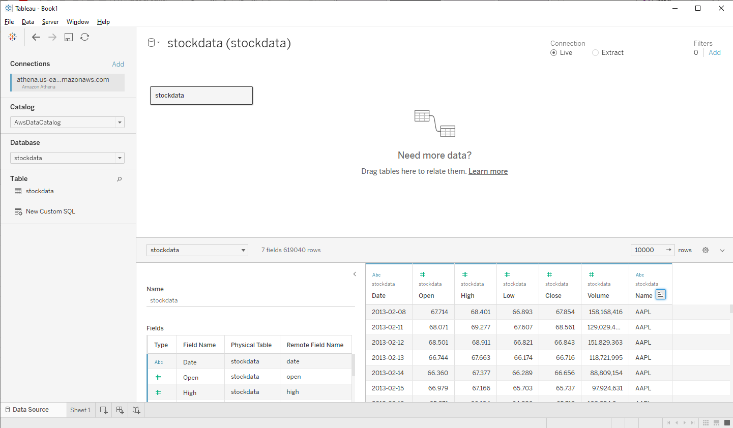

Slide 22
